Slide 1
Let's Be Reactive!
Gabriel Popovici
ReactiveX Programming

Slide 2
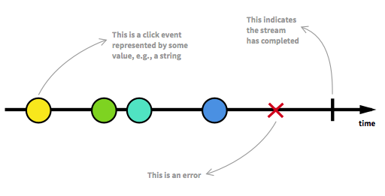
What is Reactive Programming?
Reactive Programming: a programming paradigm revolving around propagation of change!
https://en.wikipedia.org/wiki/Reactor_pattern
Reactive programming is programming paradigm style with asynchronous data streams. Data stream is central to the reactive programming style and it can be represented by a set of variables, user inputs, set of properties, data caches, data structure.The stream can easily be associated with the usual Event Bus. (https://gist.github.com/staltz/868e7e9bc2a7b8c1f754 – Andre Stalz).
Considering the diagram below - 4 sequential user events, a stream becoming the subject of being observed and the listening to the stream is called subscribing:
---------a---b--c-----d-----X----|->
A,b,c,d, represented with colourfull circles represent a sequeence of emitted user events
X might be the error
| - signals the completed stream
--------------------------> is the timeline
Blend with functional programming idioms:(e.g. map, reduce, filter,etc.) creates an functional reactive programming style.
FP
FRP
RP

Slide 3
Why Reactive ?
Raises the level of abstraction of your code so you can focus more of the interdepence of events that define the business logic
Rather than spending time watching over code implementation details you focus more and publish-subscribe side of the business requrements in an event-driven asynchronous way providing mutiple micro-services/components/modules interacting through notifications/events. This way the system is decoupled and reacts to the data flow of the system by notifications
Scalable enough to react to the ever-growing data without falling apart. Adding or removing new components without breaking the system
Reacting to failures/errors will make the system more fault-tolerant, resilient
Responsive to user activity in a timely manner

Slide 4
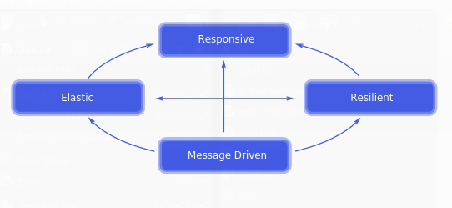
Reactive Manifesto – Reactive Systems are:
Elastic: The system stays responsive under varying workload. Reactive Systems can react to changes in the input rate by increasing or decreasing the resources allocated to service these inputs.
Responsive: The system responds in a timely manner if at all possible. Responsiveness is the cornerstone of usability and utility, but more than that, responsiveness means that problems may be detected quickly and dealt with effectively. Responsive systems focus on providing rapid and consistent response times, establishing reliable upper bounds so they deliver a consistent quality of service. This consistent behaviour in turn simplifies error handling, builds end user confidence, and encourages further interaction.
Message Driven: Reactive Systems rely on asynchronous message-passingto establish a boundary between components that ensures loose coupling, isolation and location transparency. This boundary also provides the means to delegate failures as messages. Employing explicit message-passing enables load management, elasticity, and flow control by shaping and monitoring the message queues in the system and applying back-pressurewhen necessary. Location transparent messaging as a means of communication makes it possible for the management of failure to work with the same constructs and semantics across a cluster or within a single host. Non-blocking communication allows recipients to only consumeresources while active, leading to less system overhead.
Resilient: The system stays responsive in the face of failure. This applies not only to highly-available, mission critical systems — any system that is not resilient will be unresponsive after a failure. Resilience is achieved byreplication, containment, isolation and delegation. Failures are contained within each component, isolating components from each other and thereby ensuring that parts of the system can fail and recover without compromising the system as a whole.

Slide 5
Programming Paradigms/Classification
Programming paradigm definition: a particular style of programming and a particular set of methods and techniques to reason about programs
Imperative Languages | Fortran,C,Pascal, Java, Python | Programs are decomposed into computation steps (also called commands, assignements, control statements, looping constructs or instructions), reflecting the step-wise execution of programs in usual hardware. Subprograms (also called routines, procedures, etc.) are used to build programs in a modular procedular way/traditional programming.
Functional Languages | Haskel, SML, Caml, Clean, LISP, F# | Programs are functions, which can be composed to build new functions as in the mathematical theory of functions (the basis of these languages) and avoids changing-state and mutable data.This class of languages is also called declarative, since the focus is on what should be computed, not how it should be computed. Treat functions as values and think about evaluation over execution ()
Object Oriented Languages | C++, Java, Python | Programs are collections of objects which can only be accessed through the operations (or methods) provided for them, and are usually hierarchically organised. An object can be thought of as an entity combining data (fields) and operations (methods). Object-orientation is sometimes considered as a feature of imperative languages, however, it can also be found in functional languages and it can be combined with logic languages too.
Logic Languages | Prolog | Programs describe a problem rather than defining an algorithmic implementation. Again this class of languages is declarative, since the focus is on the specification of the problem that needs to be solved and not on how it is solved.

Slide 6
Functional Programming
Characteristics | Inspiration from the lambda calculus back in the 1930s Relies on functions – First class Citizens Aims to avoid side effects (Pure Functions)/No Side Efects The only observable output is the return value The only output dependency are the input arguments Arguments are fully determined before any output result It avoids concepts such as state Promotes immutable data and declarative programming Promotes Internal Iteration vs External Iteration
Advantages | Less code Promotes reussability by lack of side effects Recursion is the natural control structure Thread safety in concurrency aspects Passin functions as method arguments, store functions in variables , return functions from other functions
Disadvantages | Not data oriented Functional programming idioms are less intuitive than traditional programming Many funtional programming have been viewed as Ivory tower languages used only in academics Interactive applications are harder to develop, the request – response cycles do not fit into the func.prog.

Slide 7
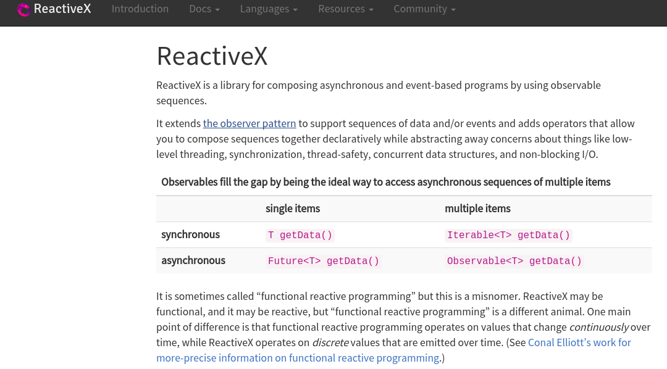
Reactive X - http://reactivex.io/intro.html

Slide 8
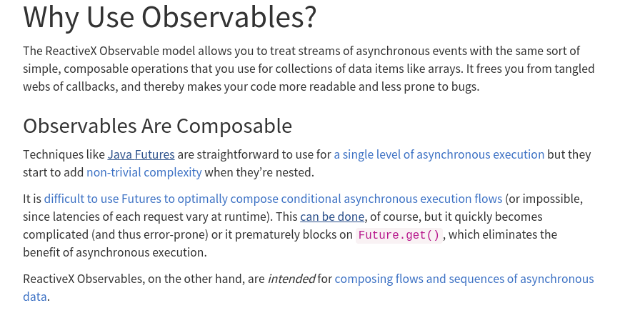
Benefits - :)

Slide 9
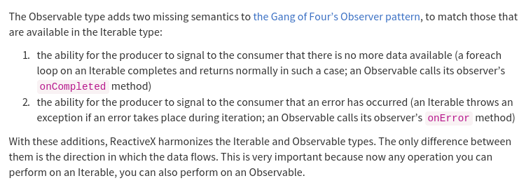
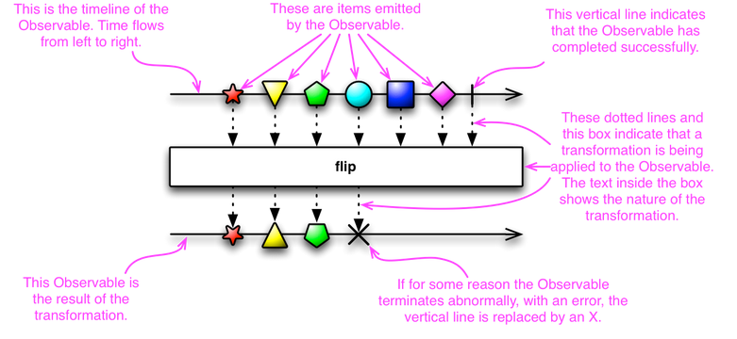

Slide 10
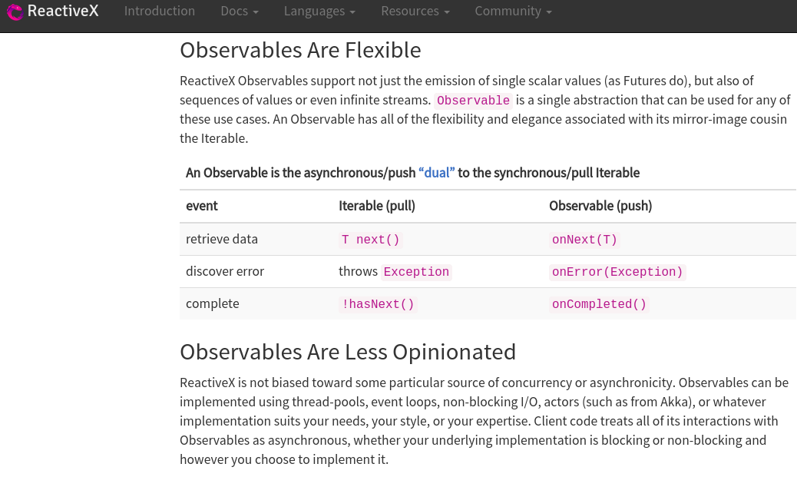
And more benefits - :)

Slide 11
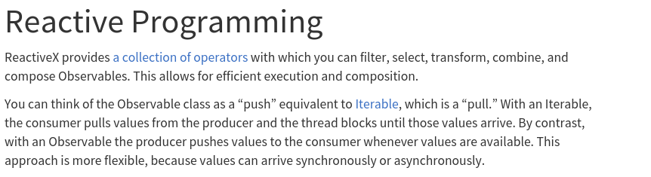
Operators By Category
Creating Observables | Create, Just, Start, Timer, Interval
Transforming Observables | GroupBy, FlatMap, Map
Filtering observables | Filter, First, Last, Skip, Take
Combining Observables | And/then/when, Join, Merge
Error Handling | Catch, retry
Utility | Timeout, using, ObserveOn, Do
Mathematical | Max, Min, Reduce, Sum, Count
Conditional | All, TakeUntil, TakeWhile, Contains, DefaultIfEmpty

Slide 12
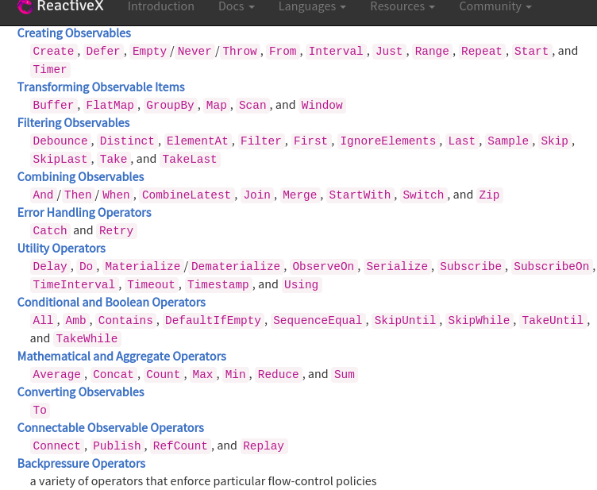

Slide 13
RxJava
RxJava is a NetFlix open source library that they developed as part of optimizing their architecture. The library is related to the “Reactive programming” pattern:
“RxJava is an implementation of Reactive Extensions – a library for composing asynchronous and event-based programs using observable sequences for the Java VM”.
https://github.com/ReactiveX/RxJava
http://reactivex.io/RxJava/javadoc/
Tutorial: https://github.com/Froussios/Intro-To-RxJava
RxJava Core concepts: Observable and Observer described in: https://github.com/Froussios/Intro-To-RxJava/blob/master/Part%201%20-%20Getting%20Started/2.%20Key%20types.md
Observable responsible for pushing events down the pipe
Values
Completition, which indicates no more values will be pushed
Errors
Observer executing onNext(), onCompleted(), onErrror()

Slide 14
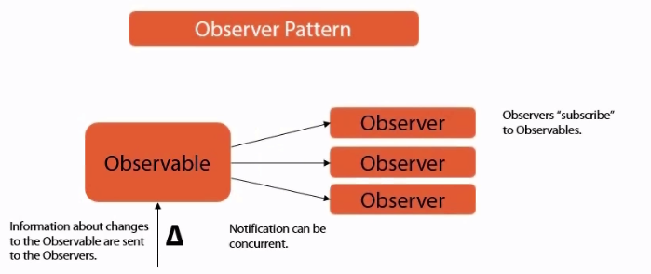
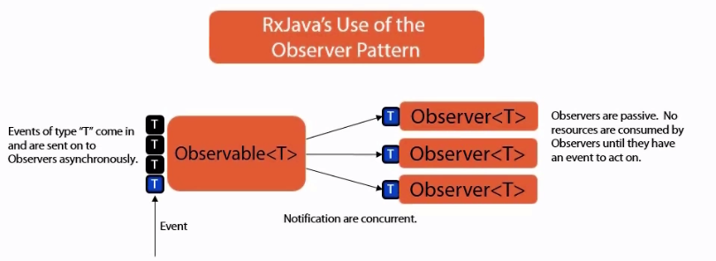

Slide 15
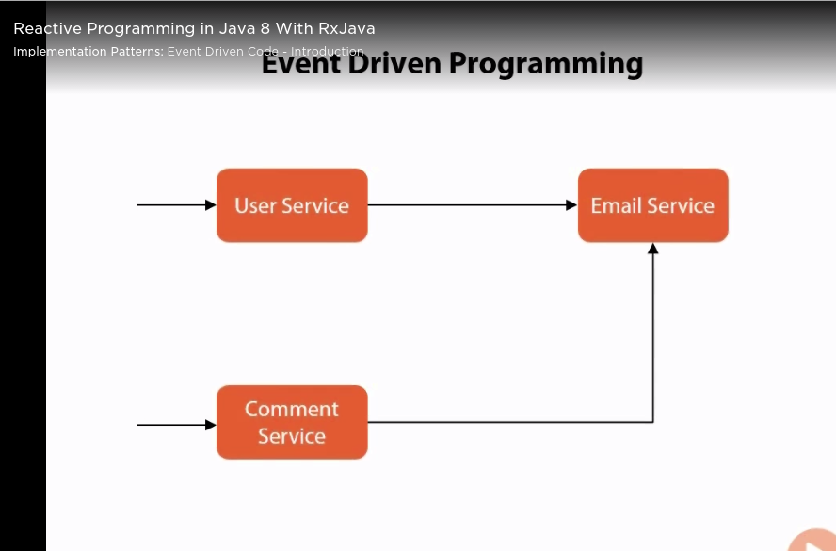
Usage – Event driven programming
Classic approach style: a UserService with a method addUser Has-A dependency
towards the EmailService and the CommentService Has-A dependency towards
The EmailService
- Characteristic: tightly coupled with one another

Slide 16
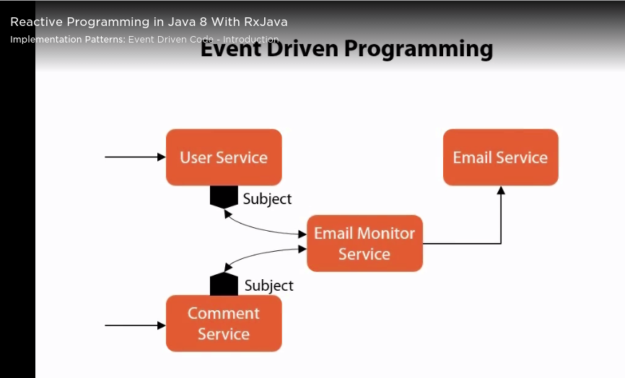
Using RxJava -Decoupling Strategy
Publish-Subscribe approach in decoupling services from one-another

Slide 17
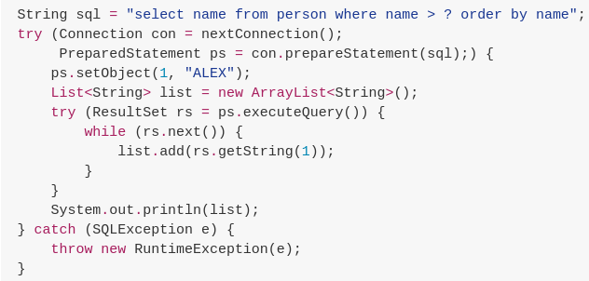
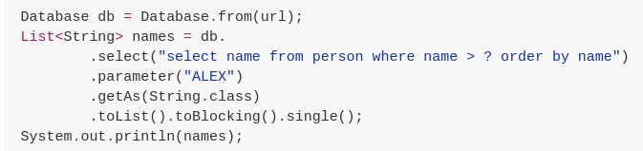
Classic style
RxJava in JDBC -samples: https://github.com/davidmoten/rxjava-jdbc
RxJava style

